Slide 1
Android Application Design
Chapter 2
Prepared By : Dharmendra Ambani (Harivandana College – Rajkot)

Slide 2
2.1) Anatomy(Structure) of an Android applications
Src : Java source code files will be available here.
Gen : The gen directory in an Android project contains auto generated files. you can see R.java inside this folder which is a generated class which contains references to certain resources of the project.R.java is automatically created by the Eclipse IDE.

Slide 3
2.1) Anatomy(Structure) of an Android applications
Res : Android supports resources like images and certain XML configuration files , these can be keeping separate from the source code.
/res/values : Used to define strings, colors, dimensions, styles, static arrays etc.
Ex. String are defined in the res/values/string.xml file.

Slide 4
2.1) Anatomy(Structure) of an Android applications
/res/layout : This folder contains the layouts to be used in the application.
/res/menu : This folder contains menu resources to be used in the application.

Slide 5
2.1) Anatomy(Structure) of an Android applications
/res/drawable : Drawable folders are resource directories in the application that provides differrent bitmap drawables for medium, hign and extra high density screens.
/res/drawable-idpi : bitmap for lower density
/res/drawable-mdpi : bitmap for medium density
/res/drawable-hdpi : bitmap for high density
/res/drawable-xhdpi : bitmap for extra high density
/res/drawable-xxhdpi : bitmap for X extra high density

Slide 6
2.1) Anatomy(Structure) of an Android applications
Libs : External library files will be places in this folder.
Assets : This folder contains raw hierarchy of files and directories, with no other capabilities.
Bin : Bin folder is the area used by the compiler to prepare the files to be finally packaged to the application’s APK file.

Slide 7
2.1) Anatomy(Structure) of an Android applications
AndroidManifest.xml : All the android applications will have an AndroidManifest.xml file in the root directory. In short it is a configuration file.
Ic_launcher-web.png : This is an icon to be used in Google play.
512 x 512 pixels

Slide 8
2.1) Anatomy(Structure) of an Android applications
Proguard-project.txt : Everything in the proguard-project.txt file will be used just run ProGuard tool with standard settings.
Project.properties : Is the main project’s properties files containing information such as the build platform target and dependancies.

Slide 9
2.2) Android Terminologies
.apk file : Android application package file.
.dex file : Compiled Android application code file. .dex files can be created by automatically translating comipiled applications written in the java programming language.
Action : An action is a string value assigned to Intent
Ex. Android.intnet.action.VIEW

Slide 10
2.2) Android Terminologies
Activity : A single screen in an application, with supporting java code, derived from the Activity class.
Adb : Android Debug Bridge, a command line debugging application includes with the SDK.
Application : From a component viewpoint, an Android application consists of one or more activities, listeners, and intent receivers.

Slide 11
2.2) Android Terminologies
Canvas : Canvas is the simplest, easiest way to draw 2D objects on the screen.
Content Provider : A content provider is built on the ContentProvider class, which handles content query strings of a specific format to return data in a specific format.
Dalvik: The Android Platform’s virtual machine. The Dalvik VM is an interpreter only VM that executes files in the Dalvik Executable (.dex) format, a format that is optimized for efficient storage and memory mappable execution.

Slide 12
2.2) Android Terminologies
DDMS : Dalvik Debug Monitor Service, a GUI debugging application included with the SDK.
Dialog : A dialog can have button controls only and is intended to perform a simple action.
Drawable : A drawable is typically loaded into another UI element , Ex. Background Image.

Slide 13
2.2) Android Terminologies
Intent : It includes several criteria fields that you can supply, activity receives the intent and what the receiver does when handling the intent.
Intent Filter : Through an intent filter, an application can express interest in specific data types, Intent actions etc.

Slide 14
2.2) Android Terminologies
Broadcast Receiver : An application class that listens for intents that are broadcast, rather that being sent to a single target application/activity.
Layout Resources : An XML file that describes that layout of an Activity scree.
Manifest File : An XML file that each application must define, to describe the app’s package name, version, component etc.

Slide 15
2.2) Android Terminologies
Resources : Non programmatic application components that are external to the compiled application code, but which can be loaded from application code.
Service : An object class service that runs in the background to perform action.

Slide 16
2.2) Android Terminologies
Surface : An object of type surface representing a block of memory that get composited to the screen
Surface View : A view object that wraps a surface for drawing and exposes methods to specify its size and format dynamically.
Theme : A set of Properties (Text size, color etc) bundled together to define various default display settings.

Slide 17
2.2) Android Terminologies
View : An object that draws to a rectangular area on the screen and handles click and events.
Viewgroup : A container object that groups is responsible for deciding where child views and representing.
Widget : One of a set of fully implemented view subclasses that render from elements and other UI component.

Slide 18
2.3) Application Context, Activities, Services, Intents
Context : is probably the most used element in android applications.
This is a class whose implementation is provided by the Android system. It allows access to application-specific resources and classes, as well as up-calls for application-level operations such as launching activities, broadcasting and receiving intents, etc
Activities
A single screen in an application, with supporting java code, derieved from activity class.

Slide 19
Activities
Priority
1)Foreground
2)visible
3)service
4)background
5)Empty

Slide 20
Activities
Activity Life cycle
An activity can be in different state which are describe by follow.
Activity State
1)Running
2)Paused
3)Stopped
4)Killed

Slide 21
Activities
Activity Life cycle methods
1)onCreate()
2)onResume()
3)onPause()
4)onStop()

Slide 22
Activities
1)onCreate()
Called when the activity is created , used to initialize activity.
For Ex. Create the user interface.
2)onResume()
Called if the activity gets visible again and the user starts interacting with activity again.
Used to initialize fields , register listeners, bind to service etc.

Slide 23
Activities
3) onPause()
Called ones another activity gets into the foreground.
Always called before the activity is not visible any more.
For Ex. You unregister listeners, intent receiver, unbind from service or remove system service listeners.

Slide 24
Activities
4) onStop()
Called ones activity is no longer visible.
Time or cpu intensive shut down operations.
For Ex. writing information to database shut be down in the on stop methods.

Slide 25
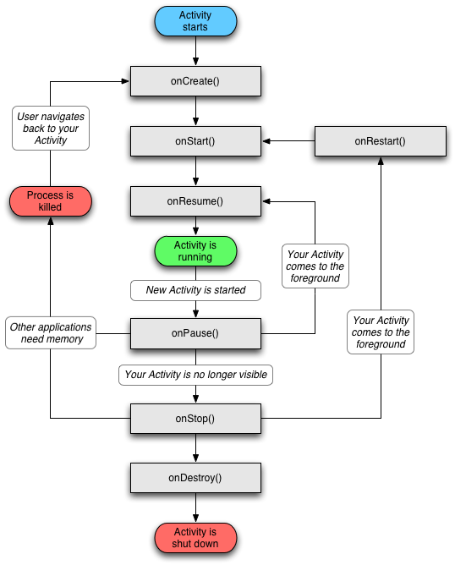

Slide 26
Services
A service is a component that runs in the background to perform long running operations without needing to interact with the user.
For Ex. Play music in the background.
Service State
1) Started
2) Bound

Slide 27
Services
1) Started
A service is started when an application component, such as an activity, starts it by calling startService().
Once started, a service can run in the background indefinite, even if the component that stated it is destroyed.

Slide 28
Services
2) Bound
A service is bound when an application component binds to it by calling bindService().
A Bound service offers a client server interface that allows components to interact with the service, send request, get results and even do so across processes with interprocess communication.

Slide 29
Services
Callback Method
1)onStartCommand()
The system calls this method when another component, such as an activity, requests that the service be started by calling startService().
2)OnBind()
The system calls this method when another components wants to bind with the service by calling bindService().

Slide 30
Services
3) onUnbind()
The system calls this method when all clients have disconnected from a particular interface published by the service.
4) onRebind()
The system calls this method when new clients have connected to the service, after it had previously been notified that all had disconnected in its onUnbind(Intent).

Slide 31
Services
5) onCreate()
The system calls this method when the sevice is first created using onStartCommand() of onBind(). This call is required to perform one time setup.
6) onDestroy()
The system calls this method when the service is no longer used and is being destroyed.

Slide 32
Intent
Types of Intent
1) Explicit Intent
Specify the component to start by name(class name).
For Example, start a new activity is response to a user action or start a service to download a file in the background.

Slide 33
Intent
2) Implicit Intents
Do not name a specific component, but instead declare a general action to perform, which allows a component from another app to handle it.
For Example, If you want to show the user a location on a map, you can use an implicit intent to request that another capable app show a specified location on a app.

Slide 34
1.4) Receiving and broadcasting Intents
A broadcast receiver listens for relevant broadcast messages to trigger an event.
Example :
A camera button was pressed.
The Battery is low.
A new application was installed.
SMS is received.
Screen has turned off.

Slide 35
1.4) Receiving and broadcasting Intents
A broadcast receiver is a class which extends "BroadcastReceiver" and which is registered as a receiver in an Android Application via the AndroidManifest.xml (or via code).
This class will be able to receive intents via the sendBroadcast() method.
"BroadCastReceiver" defines the method "onReceive()".

Slide 36
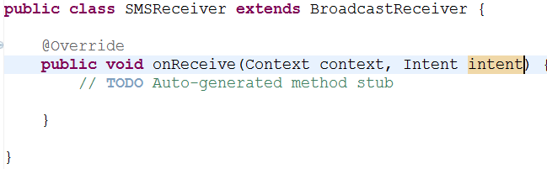
1.4) Receiving and broadcasting Intents
A broadcast receiver is implemented as a subclass of BroadcastReceiver and each
broadcast is delivered as an Intent object. In this case the intent is detected by
android.provider.Telephony.SMS_RECEIVED
To do this we’ll create a class SMSReceiver that extends BroadcastReceiver class and define the method onReceive()

Slide 37
1.5) Android Manifest File and Its Common settings
It is a specially formatted XML File that much accompany each android application.
This file contains important information about the application’s identity.
In this file we can define the
Applications' name
Version information
Permissions and
Other application configurations

Slide 38
1.5) Android Manifest File and Its Common settings
Information in this file is used by the android system to
Install and Upgrade the application package.
Display the application details such as the application name, description, and icon to users.
Specify application system requirements including which Android SDKs are supported,
What hardware configuration are required.
Which platform features the application relies upon(Eg. Uses multi touch capabilities).
Launch application activities.
Manage application permissions.

Slide 39
1.5) Android Manifest File and Its Common settings
Eclipse Manifest file resource editor organizes the manifest information into categories :
The Manifest tab
The Application tab
The Permissions tab
The Instrumentation tab
The AndroidManifest.xml tab

Slide 40
1.5) Android Manifest File and Its Common settings
Configuring Package-Wide Settings using the Manifest Tab
Its Include the package name.
Version Information.
Supported Android SDK.
Also set any hardware or
or feature requirement.

Slide 41
1.5) Android Manifest File and Its Common settings
Managing Application and Activity Settings using the Application Tab
It’s contains Application label and icon.
Application components such as activities, intent filters and other application components.
Configuration for service, intent filter, and content providers.

Slide 42
1.5) Android Manifest File and Its Common settings
Enforcing Application Permissions using the Permissions Tab
A Permission is a restriction limiting access to a part of the code or to data on the device.
The limitation is imposed to protect critical data and code that could be misused to damage the user experience.
Each permission is identified by a unique label.
Eg. :
android.permission.CALL_EMERGENCY_NUMBERS
android.permission.SET_WALLPAPER
android.permission.DEVICE_POWER

Slide 43
1.5) Android Manifest File and Its Common settings
Managing Test Instrumentation using the Instrumentation Tab
It allows the developer to declare any instrumentation classes for monitoring the application.
Instrumentation classes that provide profiling and other information as the application is running.
This declarations are present in manifest only while the application is being developed and tested, they are removed before the application is published.

Slide 44
1.5) Android Manifest File and Its Common settings
Editing the Manifest file manually
Android Manifest file is a specially formatted XML file.
We can edit manually by clicking on the AndroidManifest.xml tab.
It’s include a single <manifest> tag with a single <application> tag.
Following is a sample AndroidManifest.xml file.

Slide 45
1.5) Android Manifest File and Its Common settings
AndroidManifest.xml
<?xml version="1.0" encoding="utf-8"?>
<manifest xmlns:android="http://schemas.android.com/apk/res/android"
package="com.android.multimedia"
android:versionCode="1"
android:versionName="1.0">
<application android:icon="@drawable/icon"
android:label="@string/app_name"
android:debuggable="true">
<activity android:name=".MultimediaMenuActivity"
android:label="@string/app_name">
<intent-filter>
<action
android:name="android.intent.action.MAIN" />
<category
android:name="android.intent.category.LAUNCHER" />
</intent-filter>
</activity>

Slide 46
1.5) Android Manifest File and Its Common settings
AndroidManifest.xml
<activity android:name="AudioActivity"></activity>
<activity android:name="StillImageActivity"></activity>
<activity android:name="VideoPlayActivity"></activity>
<activity android:name="VideoRecordActivity"></activity>
</application>
<uses-permission
android:name="android.permission.RECORD_AUDIO" />
<uses-permission
android:name="android.permission.SET_WALLPAPER" />
<uses-permission
android:name="android.permission.CAMERA"></uses-permission>
<uses-sdk
android:minSdkVersion="3"
android:targetSdkVersion="8">
</uses-sdk>
<uses-feature
android:name="android.hardware.camera" />
</manifest>

Slide 47
1.6) Using Intent Filter, Permissions
Android system will determine suitable application for an implicit intent and if several applications exists offer the user the choice to open one.
Intent filters are typically defined via the “AndroidManifest.xml” file.
Implicit intents an application component must register itself via an IntentFilter in the “AndroidManifest.xml” to this event.

Slide 48
1.6) Using Intent Filter, Permissions
Define a permission using the <uses-permission> tag.
Eg.:
<uses-permission android:name=“android.permission.camera”/>
Permission can be enforce at several point :
Starting an Activity or Service
Accessing data provided by a content provider
Sending or receiving broadcasts by an Intent

Slide 49
1.7) Managing Application resources in a hierarchy
Storing Application Resources.
Understanding the Resource Directory Hierarchy.
/res/drawable/
/res/layout/
/res/values/

Slide 50
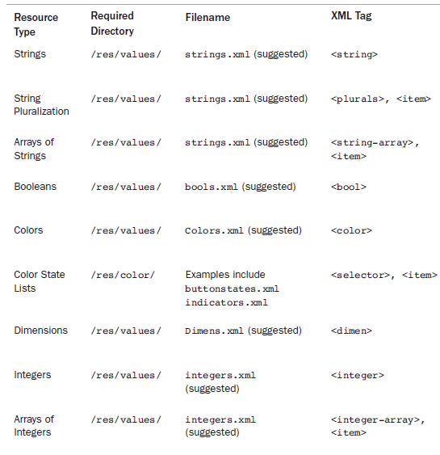
1.7) Managing Application resources in a hierarchy

Slide 51
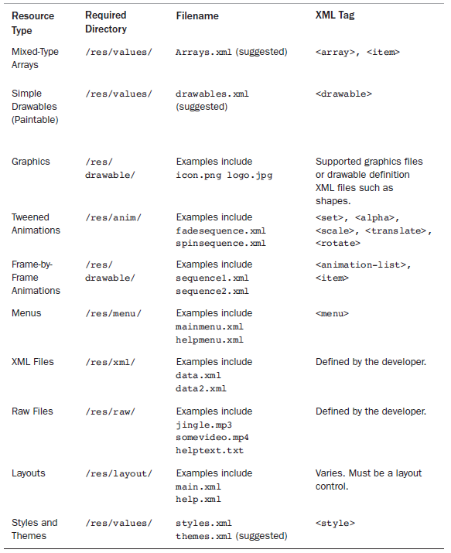
1.7) Managing Application resources in a hierarchy

Slide 52
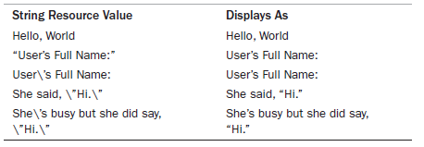
1.8) Working with different types of resources
Working with string resources.

Slide 53


1.8) Working with different types of resources
Using string resources as Format String.
Using string resources programmatically.
Working with string array.

Slide 54


1.8) Working with different types of resources
Working with Boolean Resources.
Working with Integer Resources.

Slide 55


1.8) Working with different types of resources
Working with colors.
Working with simple drawable.

Slide 56
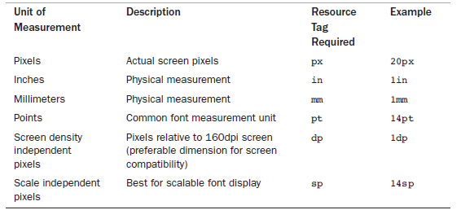
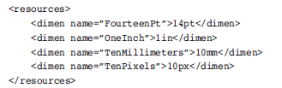
1.8) Working with different types of resources
Working with Dimensions.

Slide 57
1.8) Working with different types of resources
Working with Dimensions.

Slide 58
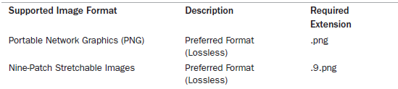

1.8) Working with different types of resources
Working with Images.

Slide 59
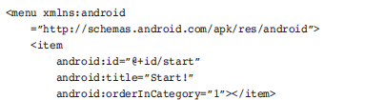
1.8) Working with different types of resources
Working with Animation.
Defining and using frame by frame Animation Resources.
Defining and using tweened Animation resources.
Working with Menus.

Slide 60
1.8) Working with different types of resources
Working with XML Files.
Working with Raw Files.
Working with Layouts.
Working with Styles.
References System Resources.

